Slide 1
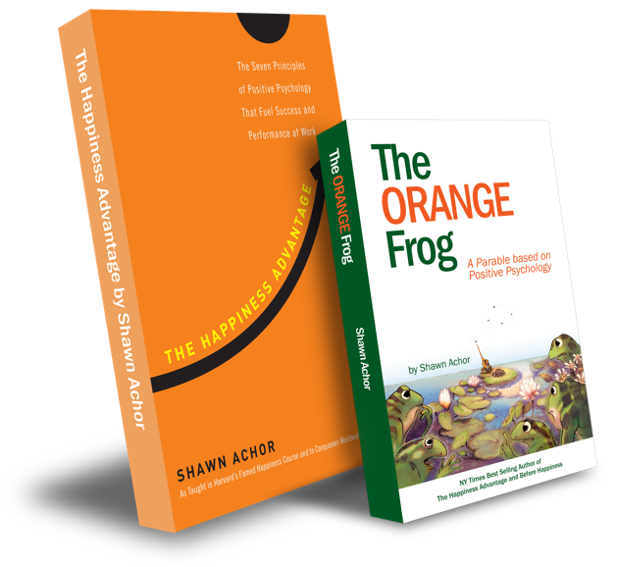
The Happiness Advantage
and
The Orange Frog
By Shawn Achor

Slide 2
High School Week Two
Notes:
Book: https://www.orangefrogschools.com/high-school/ofbook

Slide 3
The Orange Frog
Learning Objective:
I can read to The Orange Frog parable
I will discuss the central theme of the Orange Frog and will discover connections for my everyday life
Notes:
Standard:
Essential Concept and/or Skill: Communicate and work productively with others emphasizing collaboration and cultural awareness to produce quality work.
Interact positively as a team member.
Cooperate with others in a group setting.
Generate ideas with group members.
Are active listeners.
Read and understand information in a variety of forms.
Express ideas.
Skill:
Active listening, express ideas
Allow Spark to read pages 13-18 for the students or read to them.
https://www.orangefrogschools.com/elementary/ofkidsbook

Slide 4
Skills
Listen actively
Express Ideas

Slide 5
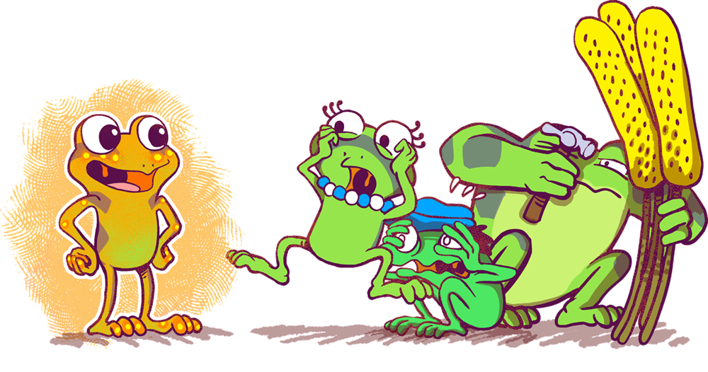
Opening Questions
What do you remember about the story we started reading last week?
Tell me about the four frogs that we met.
How were they alike?
How were they different?
Notes:
Facilitate discussion.

Slide 6
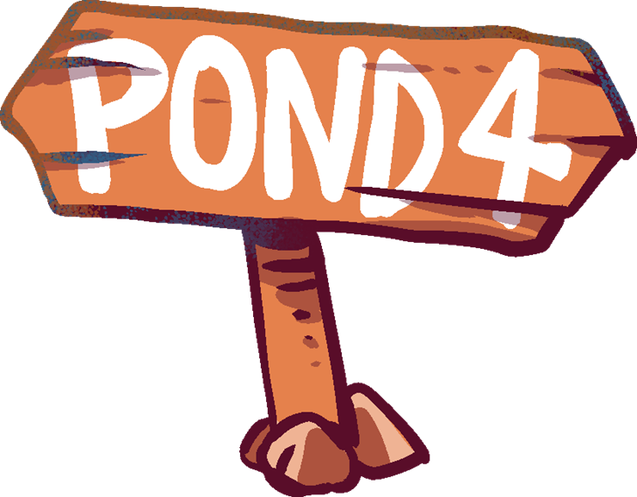
Thoughts
In the beginning of Chapter 3, we learn about the four different ponds for newly transitioned frogs. Bull seems to make a wise choice, but Plop is disinterested and doesn’t really care. The four frogs are randomly chosen to live in Pond 4.
Spark chooses to be Orange, mentioning the beauty of the Pond. He ultimately maximizes on his color and catches an abundance of flies. By the end of Chapter, he is entirely Orange.
Notes:
Recap

Slide 7
Action
We are going to try to replicate some of the things that Spark does when he becomes more Orange. What was one of the things you remember?” Could be doing something kind for others, meditating, making a choice to be Orange.
“What things are you doing in your everyday life that promote healthy wholeness?”
“In my everyday life, I __________. I know this helps to bring a healthy wholeness because __________.
Notes:
**This writing prompt can be uploaded on Google Classroom and students can be asked to do a post a response. (This gives students a chance to develop their ideas, publish their thoughts, and read the thoughts of their peers.)

Slide 8
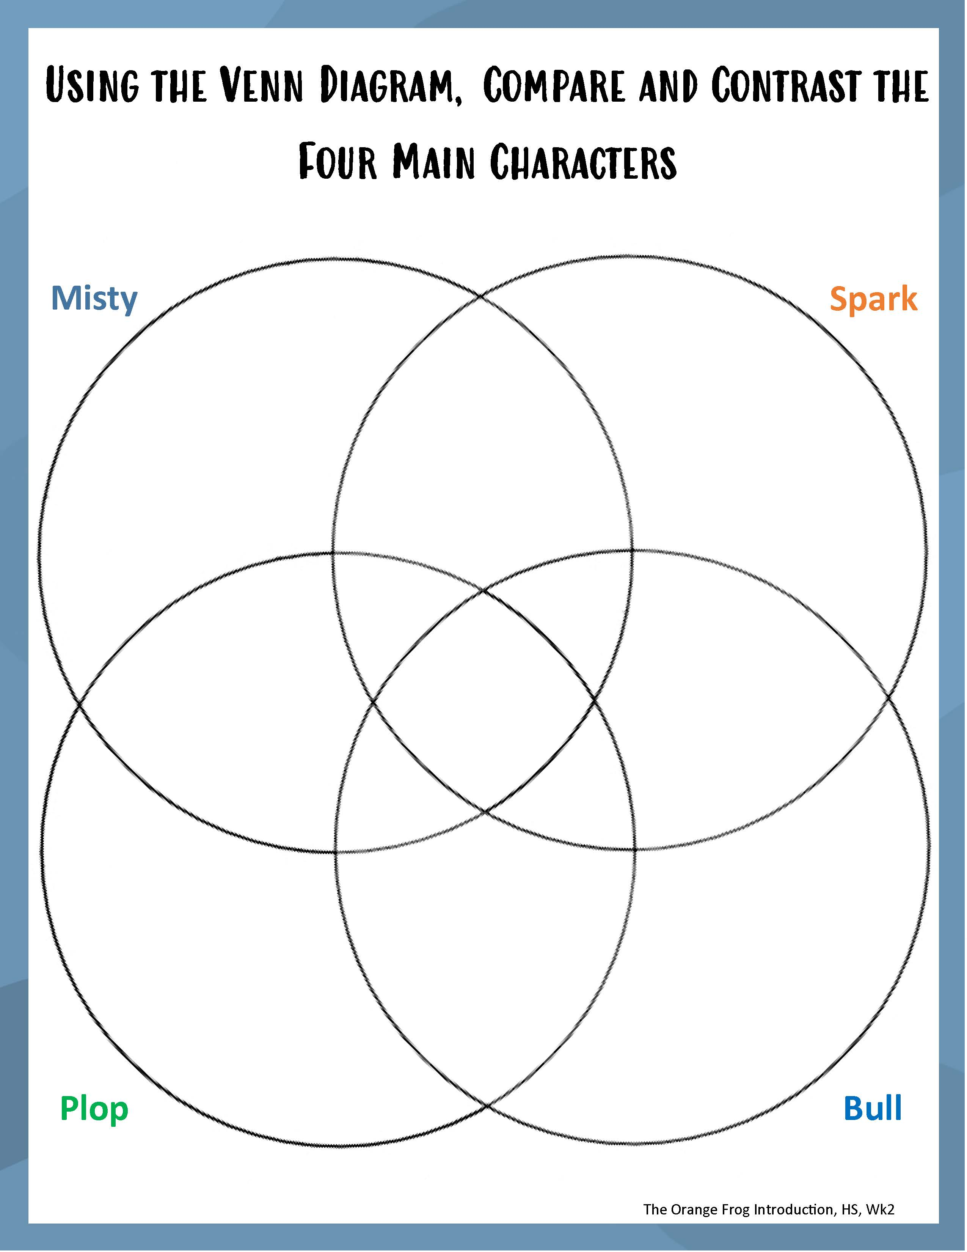
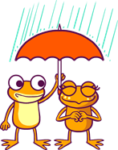
ACTIVITY
Notes:
You can either use this as a group activity and share on a projector or print out copies provided on the website for students to cut and paste the pictures on their own.
Click the image to open a PDF version.

Slide 9
Bonus Questions
What are some of the things that turn Spark more Orange?
What three things do frogs on the Island talk about?
What pond does Bull want to live on?
What does Plop say when he finds out he will be on Pond 4?

